Slide 1

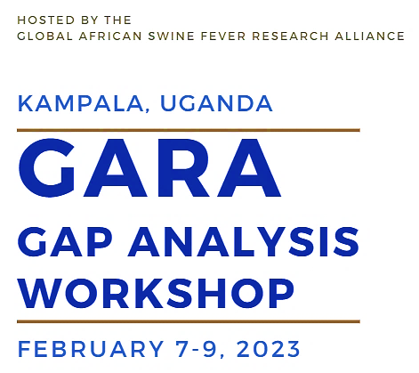

Slide 2

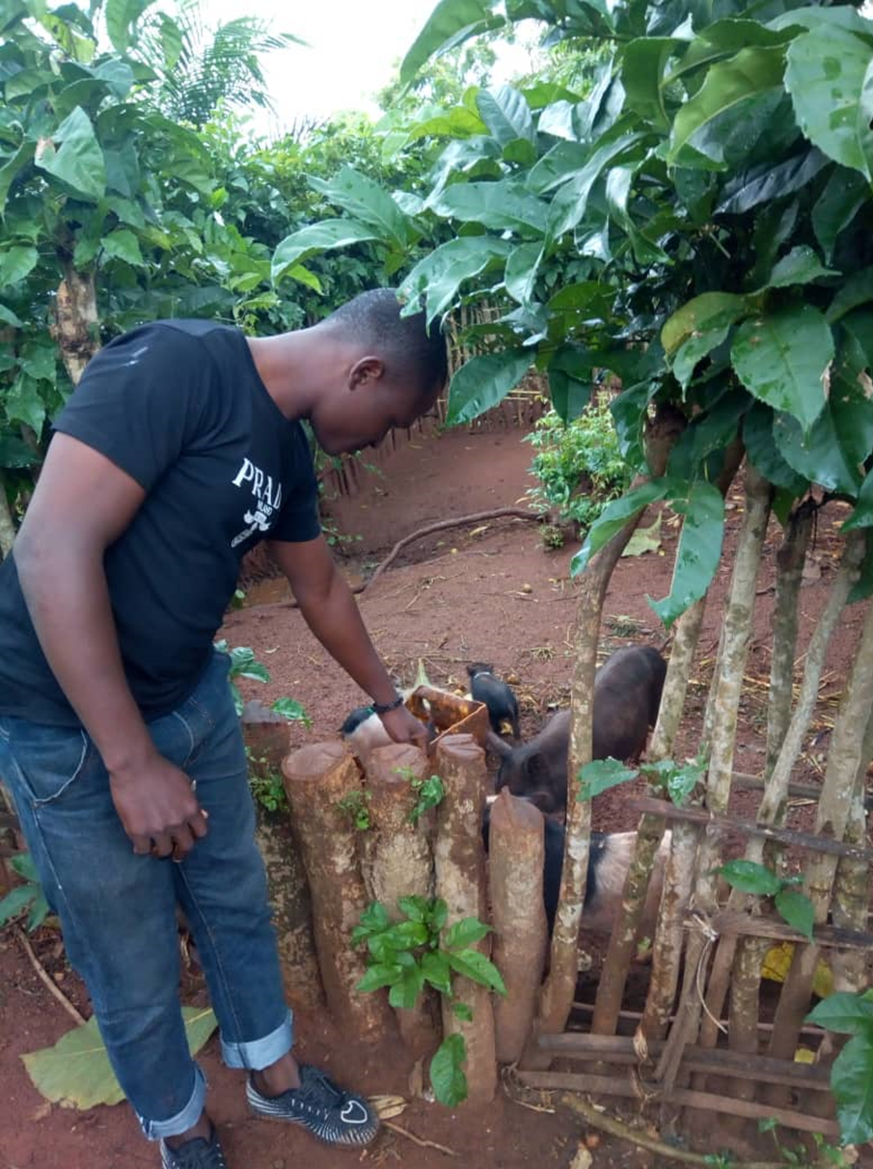
Presenter
Okri Fréjus Hans OHOUKO
Ph.D in Animal Health and Pharmacology
Junior Researcher at the University of Abomey-Calavi (BENIN)
ohoukofrjus@yahoo.com
+229 64 30 12 84

Slide 3


UNIVERSITY OF ABOMEY-CALAVI (BENIN)
Research Unit in Applied Microbiology and Pharmacology of natural substances
Combating antimicrobial resistance of microorganisms
Valorization of medicinal plants

Slide 4

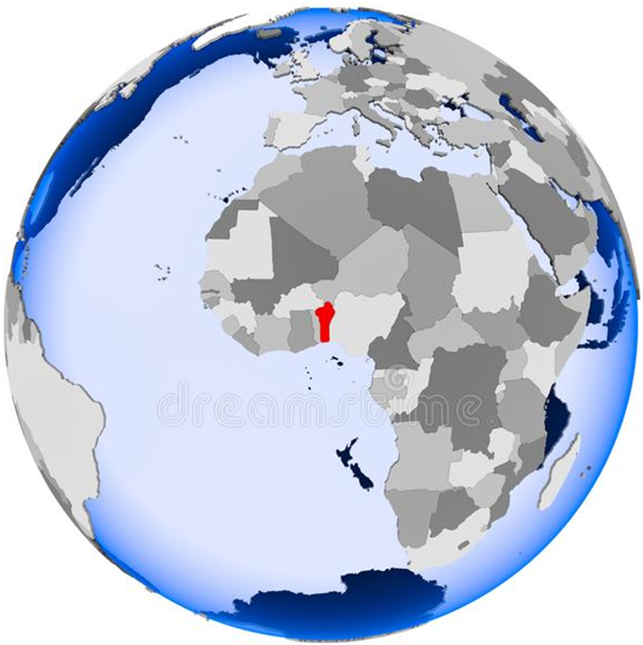

TOPIC
Current state of African swine fever research in BENIN

Slide 5
Outline
Pig production in BENIN and ASF occurrence
Research updates by subject area
ASF control in BENIN: some of the key challenges faced
Vision for the swine sector in BENIN for the next 5 years/10 years
Expectations from ASF GAP Analysis

Slide 6
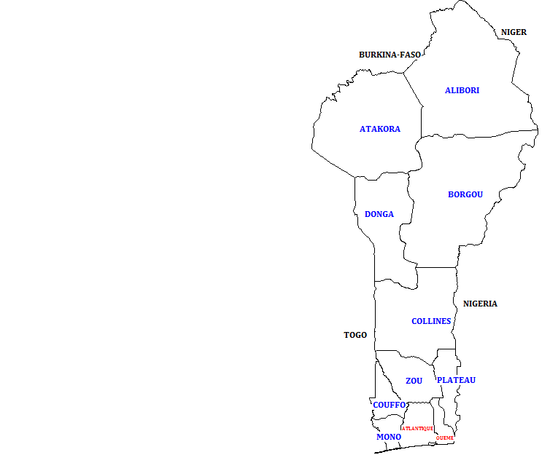

Pig production in Benin and ASF occurrence (1/4)
Pig production is mainly developed in the south
  Favorable social and cultural framework
  Rising demand for pork
  Generating employment and improving incomes for people in both rural and urban areas
  (Ohouko et al., 2020)

Slide 7
Pigs production in Benin and ASF occurrence (2/4)
ASF first occurrence
Pigs production in Benin from 1961 to 2019

Slide 8
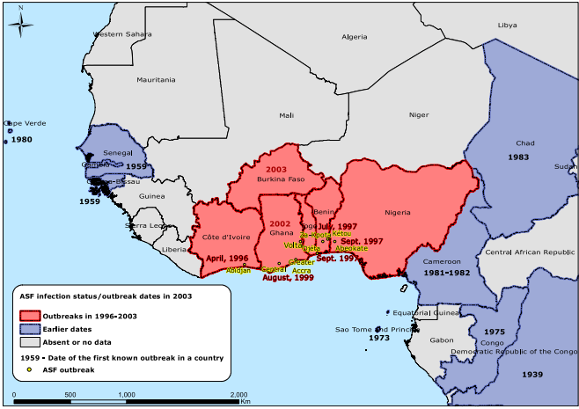
Pigs production in Benin and ASF occurrence (3/4)
First outbreak
    International market
Source of infection
    Not established
African swine fever between 1996 and 2003 in West Africa; Brown et al. (2017)

Slide 9
Pigs production in Benin and ASF occurrence (4/4)
BENIN
1996-2018: BENIN
Record high number of ASF Outbreak
(Calkin & Scasta, 2020)

Slide 10
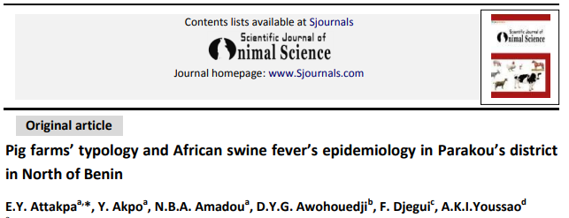
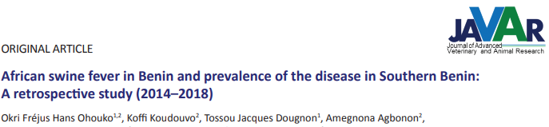
Research updates by subject area (1/6)
Epidemiology
Attakpa et al.(2014)
41 Organs: 78.05% positive by PCR
24 Serum: 12.5% positive with ELISA
No quarantine, No heating of kitchen residue, free ranging
Ohouko et al.(2020)
Pigs suspected of ASF: confirmation
Sharing of boar, wandering pigs

Slide 11
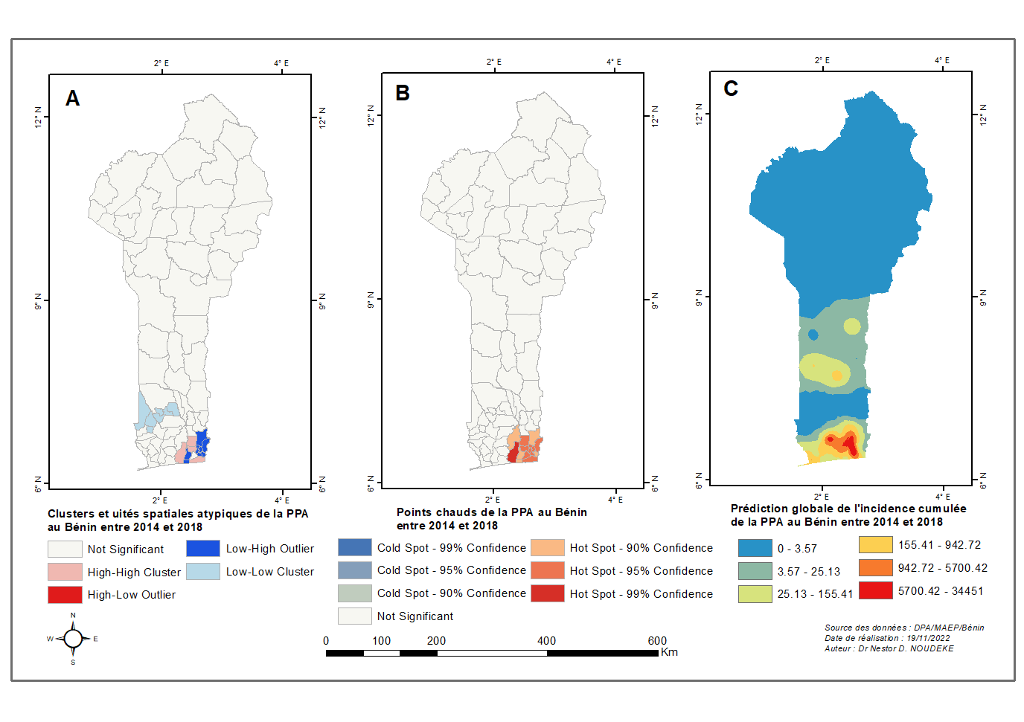
Research updates by subject area (2/6)
Epidemiology
Spatial analysis of ASF in Benin from 2014-2018 (Ohouko et al., upcoming)
A global cluster method (Moran’s I): Presence of clusters
Local indicators of spatial association, Getis Ord, and SaTScan: Location of clusters
Overall African swine fever clusters and outliers
Overall African swine fever hotspots
Overall predictive cumulative incidence of ASF
African Swine fever clusters and outliers (A), hotspots (B), and risk map (C) based on overall cumulative incidence

Slide 12
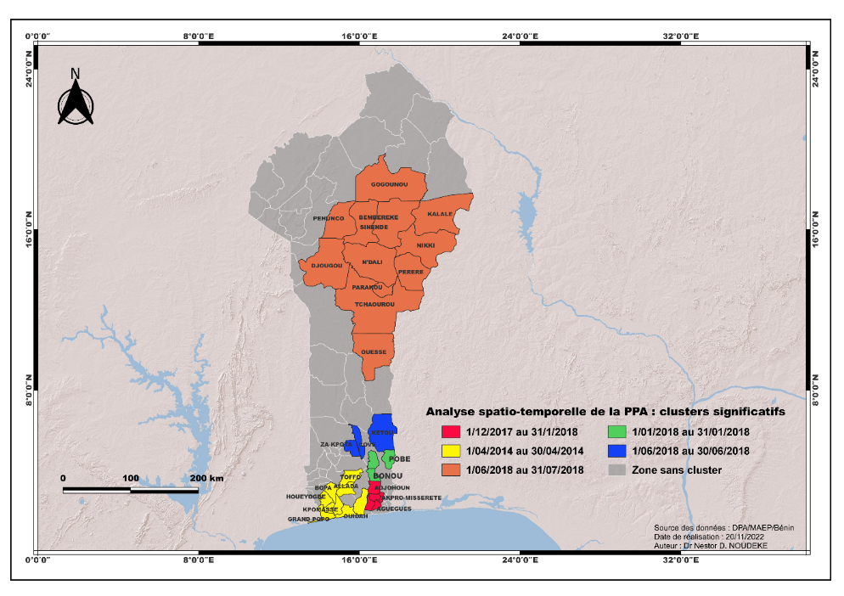
Research updates by subject area (3/6)
Epidemiology
Space-Time analysis of ASF in Benin from 2014-2018 (Ohouko et al., upcoming)

Slide 13
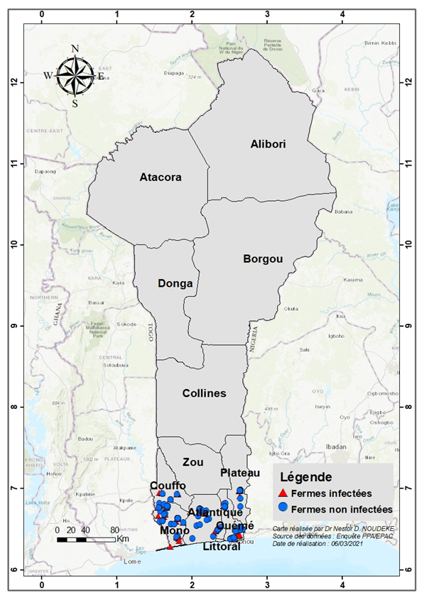
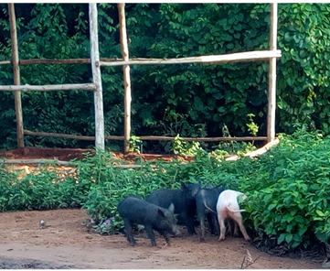
Research updates by subject area (4/6)
Epidemiology
Risk factors of ASF in BENIN (Ohouko et al., upcoming)
Piggeries in agglomeration
No quarantine
Presence of ticks
Free ranging of local breed

Slide 14
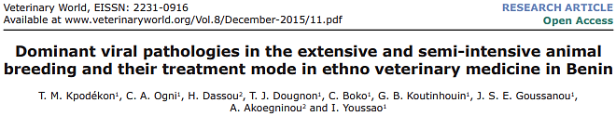
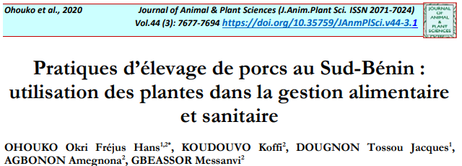
Research updates by subject area (5/6)
Drugs and therapeutics approach
Cissus quadrangularis L. (stem bark)
Adansonia digitata L. (fruits)
Momordica charantia L. (whole plant)
Ageratum conyzoides L (whole plant)
Cochlospermum planchonii Hook.f. (root )
Datura metel L. (leaves)
Cussonia arborea Hoehst. ex A. Rich. (seeds)
Kpodékon et al.(2015)
Ohouko et al.(2020)
Cochlospermum planchonii Hook.f. (root)

Slide 15
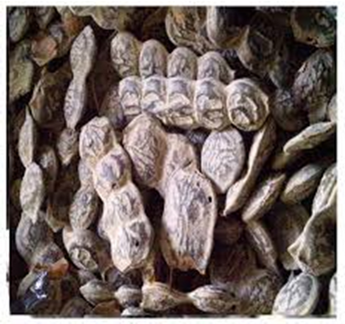

Research updates by subject area (6/6)
Drugs and therapeutics approach
TEST: CURATIVE TREATMENT WITH PLANTS EXTRACTS
Positive group
  2 days of survival
Groups treated
  2 ml/kg of body weight
  7 days of survival
Acacia nilotica
Aloe vera
Ohouko et al.(2022)

Slide 16
ASF Control in BENIN: Challenges (1/3)
01 October 1997–01 July 1999: FAO funded projects on African swine fever
+
Government policy in the ASF management
FAIL IN ASF ERADICATION
Endemic situation

Slide 17

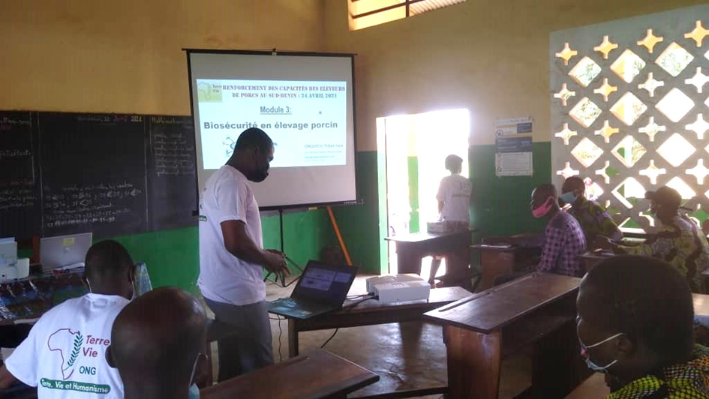
ASF Control in BENIN: Challenges (1/3)
Compliance with biosecurity measures
    Training of farmers on Biosecurity in pig keeping
(NGO Terre & Vie, 2021)

Slide 18
ASF Control in BENIN: Challenges (1/3)
Implementation and surveillance of restrictive decisions
Regional program of west African countries in fighting ASF

Slide 19

Vision for the swine sector in BENIN for the next 5 years/10 years
Rising of pig production through conversion of informal sector
Reducing in socio-economic impact of ASF
Improve the pig and pork value chains

Slide 20
Expectation from ASF Gap analysis
Capacity building on strategy of ASF control at country level
Research collaboration for scientific knowledge production on ASF
Partnership for the adoption of new tools in ASF control
Key decisions for research improvement and intervention in fighting against ASF

Slide 21


